Slide 1
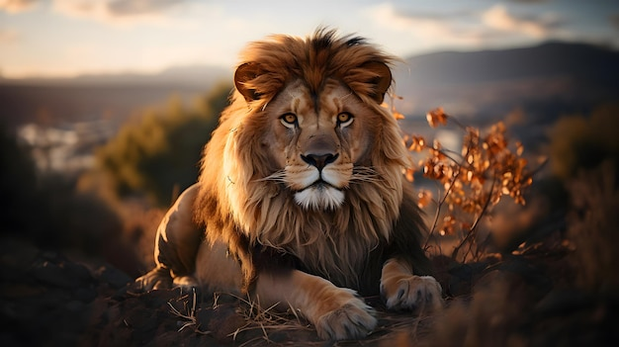
Diseases of the Pharynx and Esophagus
By
Dr. Hussein AlNaji

Slide 2
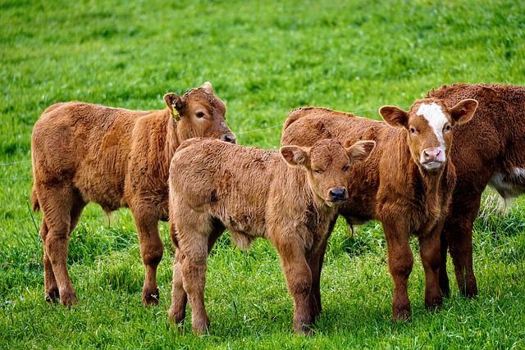
PHARYNGITIS
Pharyngitis is inflammation of the pharynx and is characterized clinically by coughing, painful swallowing, and a variable appetite.
Regurgitation through the nostrils and drooling of saliva may occur in severe cases.
ETIOLOGY
Pharyngitis in farm animals is usually traumatic. Infectious pharyngitis is often part of a syndrome with other more obvious signs.

Slide 3

Physical Causes
Injury while giving oral treatment with balling or drenching gun or following endotracheal intubation.
Improper administration of a reticular magnet, resulting in a retropharyngeal abscess.
Accidental administration or ingestion of irritant or hot or cold substances.
Foreign bodies, including grass and cereal awns, wire, bones, and gelatin capsules lodged in the pharynx.

Slide 4

Infectious Causes
Cattle
Oral necrobacillosis and actinobacillosis as a granuloma rather than the more usual lymphadenitis.
Infectious bovine rhinotracheitis
Pharyngeal phlegmon or intermandibular cellulitis is a severe, often fatal, necrosis of the wall of the pharynx and peripharyngeal tissues.

Slide 5
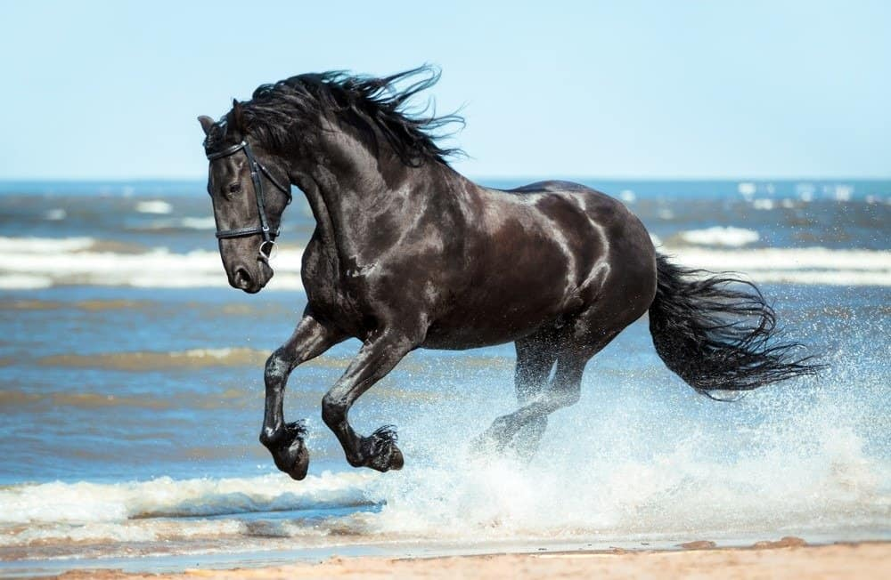
Horses
As part of strangles or anthrax
Viral infections of the upper respiratory tract, including equine herpesvirus, parainfluenza virus, adenovirus, rhinovirus, viral arteritis, and influenza-1A/E1 and 1A/ E2, cause pharyngitis.
Chronic follicular pharyngitis with hyperplasia of lymphoid tissue in pharyngeal mucosa giving it a granular, nodular appearance with whitish tips on the lymphoid follicles

Slide 6
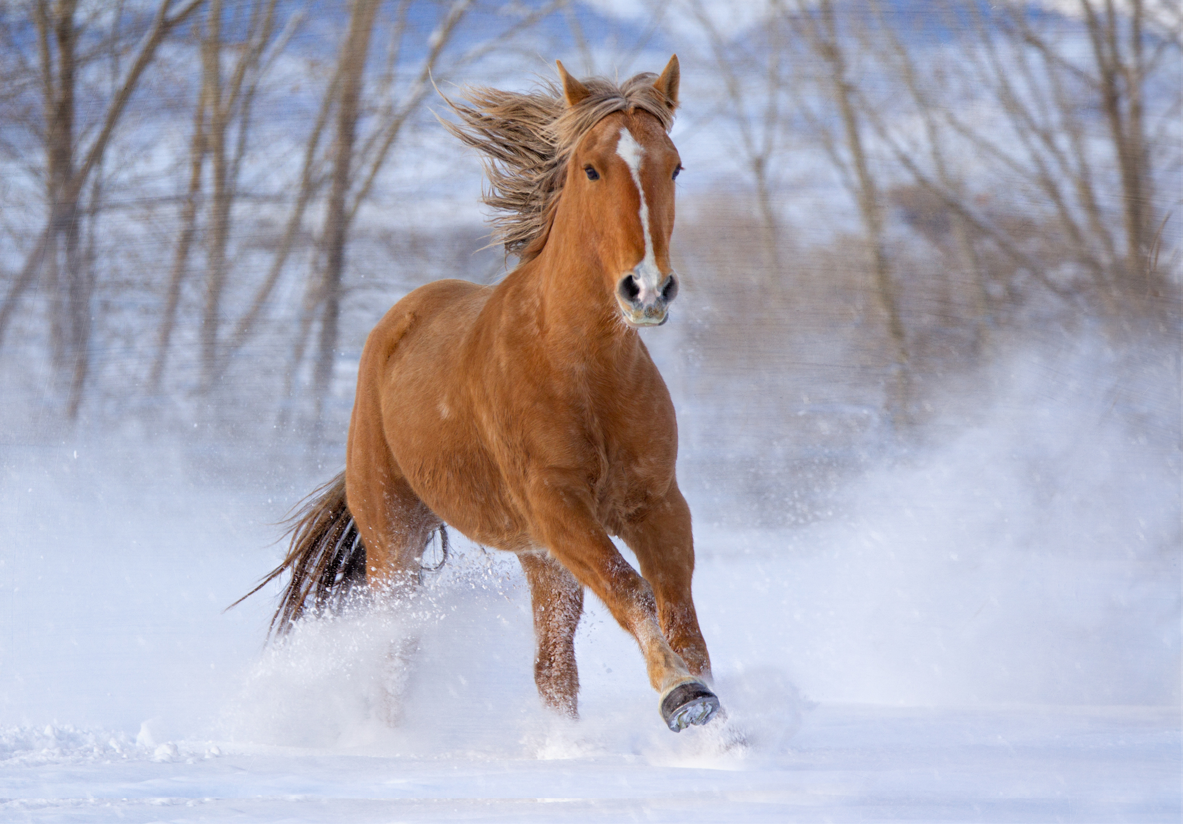
PATHOGENESIS
Inflammation of the pharynx is attended by painful swallowing and disinclination to eat. If the swelling of the mucosa and wall is severe, there may be virtual obstruction of the pharynx.
This is especially so if the retropharyngeal lymph node is enlarged, as it is
likely to be in equine viral infections such as rhinovirus.

Slide 7

CLINICAL FINDINGS
The animal may refuse to eat or drink or it may swallow reluctantly and with evident pain.
Opening of the jaws to examine the mouth is resented and manual compression of the throat from the exterior causes paroxysmal coughing. There may be a mucopurulent nasal discharge, sometimes containing blood, spontaneous cough.
Affected animals often stand with the head extended, drool saliva, and make frequent tentative jaw movements.

Slide 8

4. In “pharyngeal phlegmon” in cattle there there is an acute onset with high fever (41– 41.5°C, rapid heart rate, profound depression, and severe swelling of the soft tissues within and posterior to the mandible to the point where dyspnea is pronounced. Death usually occurs 36 to 48 hours after the first signs of illness.
5. In traumatic pharyngitis in cattle, visual examination of the pharynx through the oral cavity reveals hyperemia, lymphoid hyperplasia, and erosions covered by diphtheritic membranes.
6. Palpation of the pharynx may be performed in cattle with the use of a gag if a foreign body is suspected, and endoscopic examination through the nasal cavity is possible in the horse.

Slide 9

DIFFERENTIAL DIAGNOSIS
Pharyngitis is manifested by an acute onset and local pain.
In pharyngeal paralysis, the onset is usually slow.
Acute obstruction by a foreign body can occur rapidly and cause severe distress and continuous, expulsive coughing, but there are no systemic signs.
Endoscopic examination of the pharyngeal mucous membranes is often diagnostic.

Slide 10

TREATMENT
The primary disease must be treated, usually parenterally, by the use of antimicrobials. Pharyngeal phlegmon in cattle is frequently fatal and early, intensive antimicrobial treatment is indicated.

Slide 11

PHARYNGEAL OBSTRUCTION
Obstruction of the pharynx is accompanied by stertorous respiration, coughing, and difficult swallowing.
ETIOLOGY
Foreign bodies or tissue swellings are the usual causes.
Foreign Bodies
Foreign bodies include bones, corn cobs, and pieces of wire. Although horses are considered discriminating eaters in comparison to cattle, they will occasionally pick up pieces of metal while eating.

Slide 12

Tissue Swellings
Cattle
Retropharyngeal lymphadenopathy or abscess caused by tuberculosis, actinobacillosis, or bovine viral leucosis.
Fibrous or mucoid polyps are usually pedunculated because of traction during swallowing and can cause intermittent obstruction of air and food intake.

Slide 13
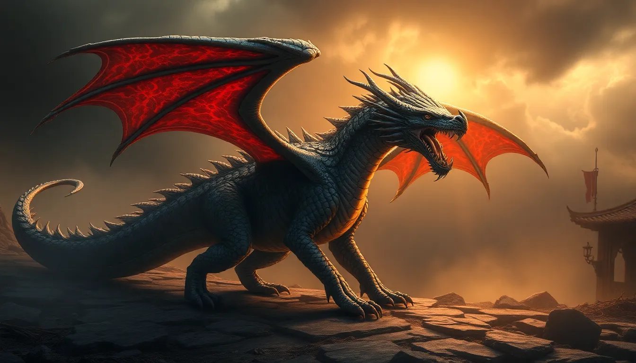
2. Horses
Retropharyngeal lymph node hyperplasia and lymphoid granulomas as part of pharyngeal lymphoid hyperplasia.
Retropharyngeal abscess and cellulitis
Retropharyngeal lymphadenitis caused by strangles.
Pharyngeal cysts in the subepiglottic area of the pharynx, probably of thyroglossal duct origin, and fibroma.
Dermoid cysts and goitrous thyroids.

Slide 14

PATHOGENESIS
Reduction in caliber of the pharyngeal lumen interferes with swallowing and respiration.
CLINICAL FINDINGS
There is difficulty in swallowing and animals can be hungry enough to eat but, when they attempt to swallow, cannot do so and the food is coughed up through the mouth.
Drinking is usually managed successfully.
An obvious sign is a snoring inspiration, often loud enough to be heard some yards away.

Slide 15
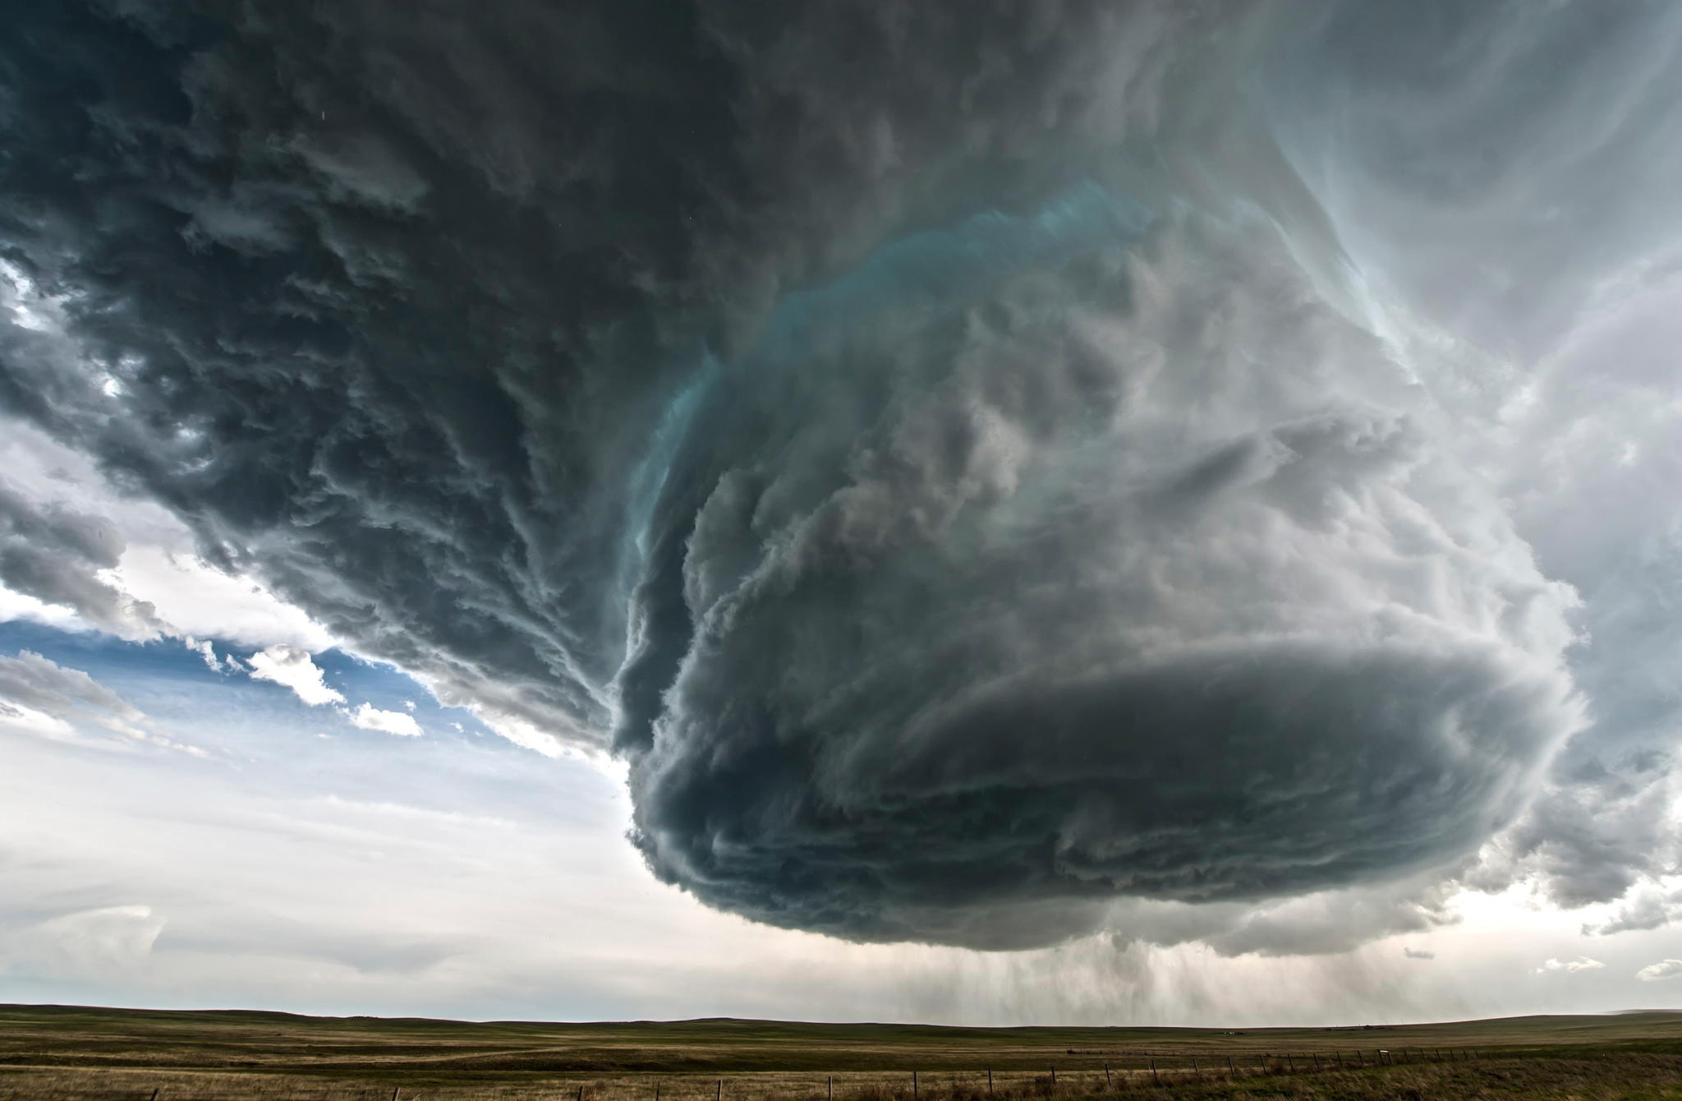
4. Auscultation over the pharynx reveals loud inspiratory stertor.
5. Manual examination of the pharynx can reveal the nature of the lesion.
6. In horses with metallic foreign bodies in the oral cavity or pharynx, the clinical findings include purulent nasal discharge, dysphagia, halitosis, changes in phonation, laceration of the tongue and stertorous breathing.

Slide 16
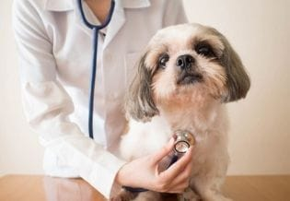
CLINICAL PATHOLOGY
A tuberculin test might be advisable in bovine cases in areas where bovine tuberculosis is endemic.
Nasal swabs can containS. equi when there is streptococcal lymphadenitis in horses.
DIFFERENTIAL DIAGNOSIS
Signs of the primary disease can aid in the diagnosis in tuberculosis, actinobacillosis, and strangles.
Pharyngitis is accompanied by severe pain, systemic signs are common, and there is usually stertor.
This Photo by Unknown Author is licensed under CC BY

Slide 17
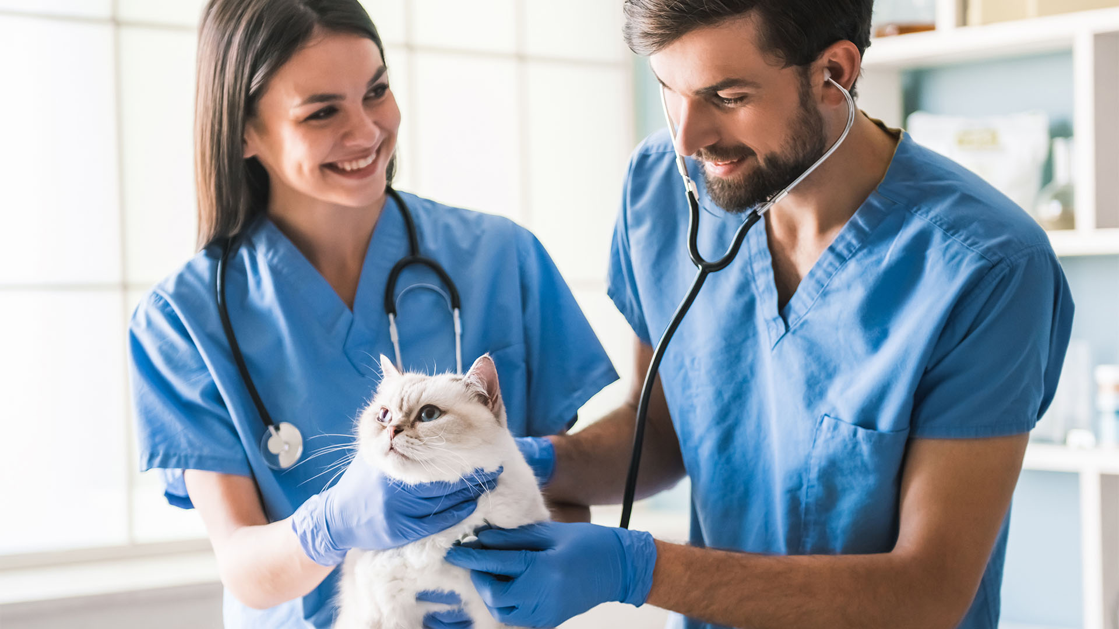
4. It is of particular importance to differentiate between obstruction and pharyngeal paralysis when rabies occurs in the area. Esophageal obstruction is also accompanied by the rejection of ingested food, but there is no respiratory distress. Laryngeal stenosis can cause a comparable stertor, but swallowing is not impeded. Nasal obstruction is manifested by noisy breathing, but the volume of breath from one or both nostrils is reduced and the respiratory noise is more wheezing than snoring.
5. Radiography is useful for the identification of metallic foreign bodies.

Slide 18
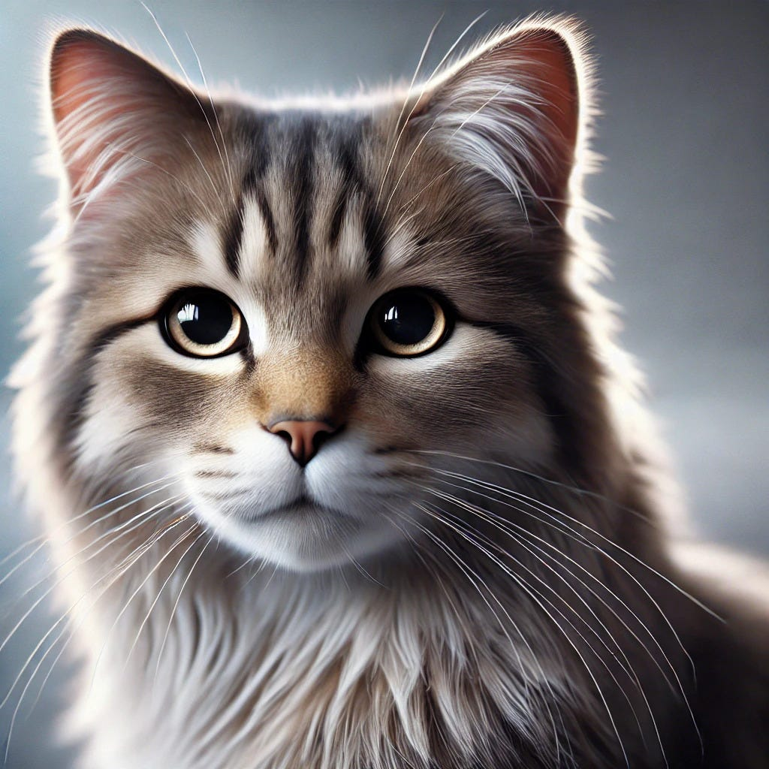
TREATMENT
Removal of a foreign body can be accomplished through the mouth.
Treatment of actinobacillary lymphadenitis with iodides.
Parenteral treatment of strangles abscesses with penicillin can affect a cure.
Surgical treatment has been highly successful in cases caused by medial retropharyngeal abscess.

Slide 19

THANK YOU

